Slide 1

Mobile App Development II COMP3097
Lecture 3
Przemyslaw Pawluk

Slide 2
Table of contents
xCode overview
iOS projects
Cocoa Classes
Communication between objects
Storyboarding and SwiftUI
Views and Controllers

Slide 3
xCode and iOS project

Slide 4
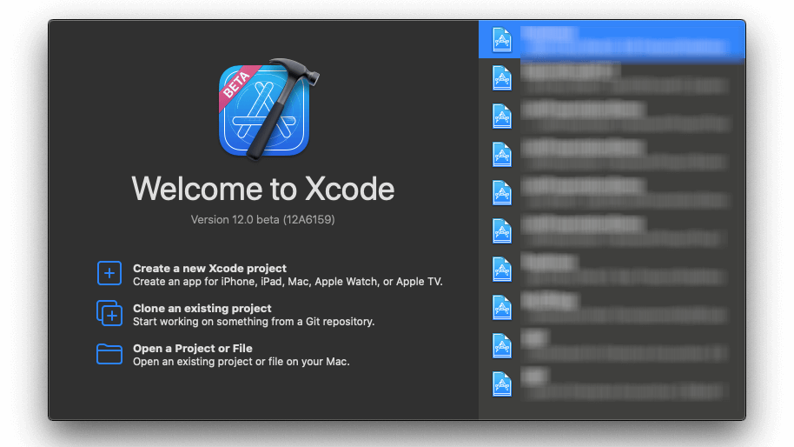

Slide 5
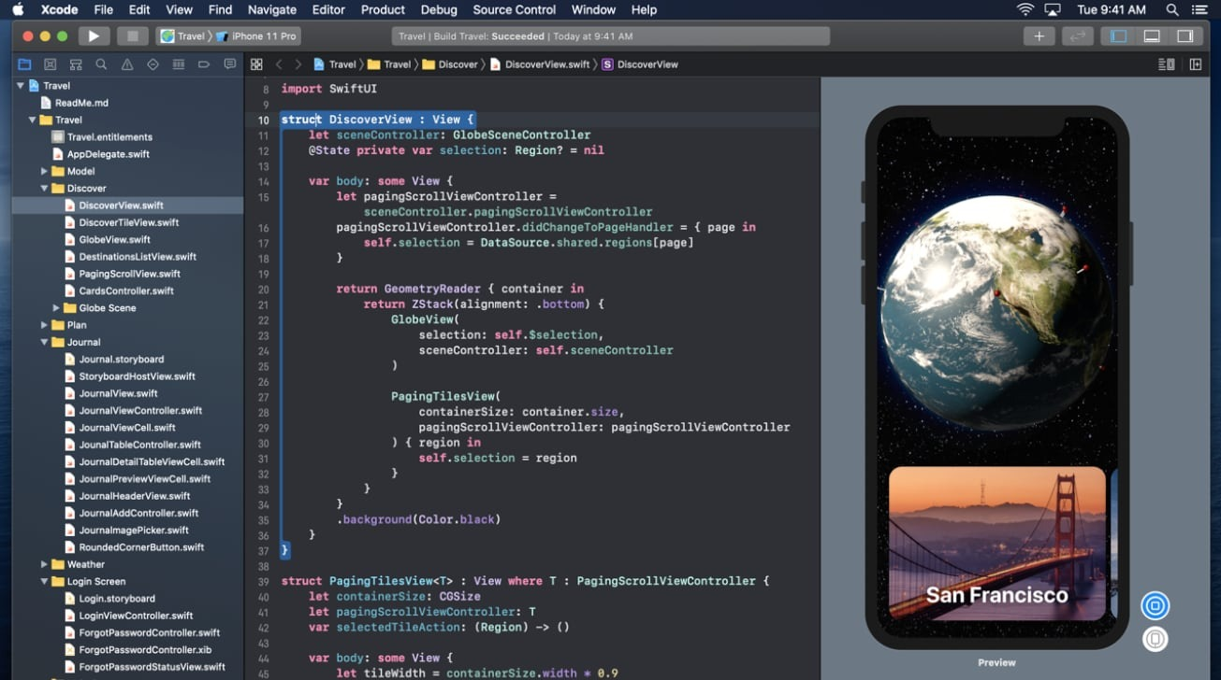

Slide 6
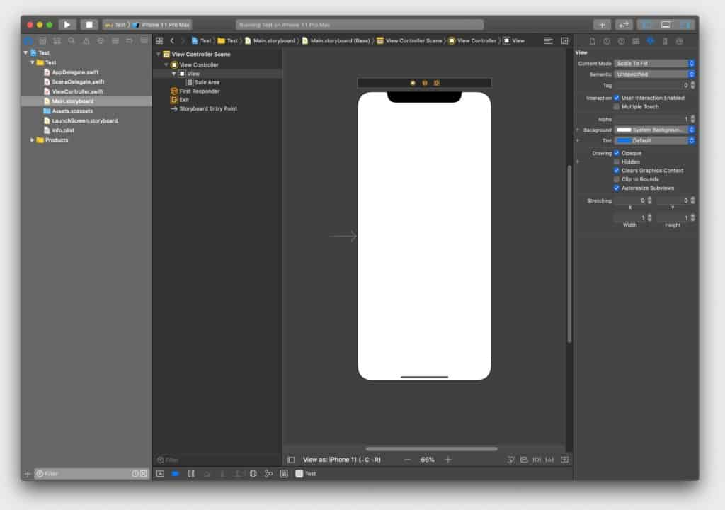

Slide 7
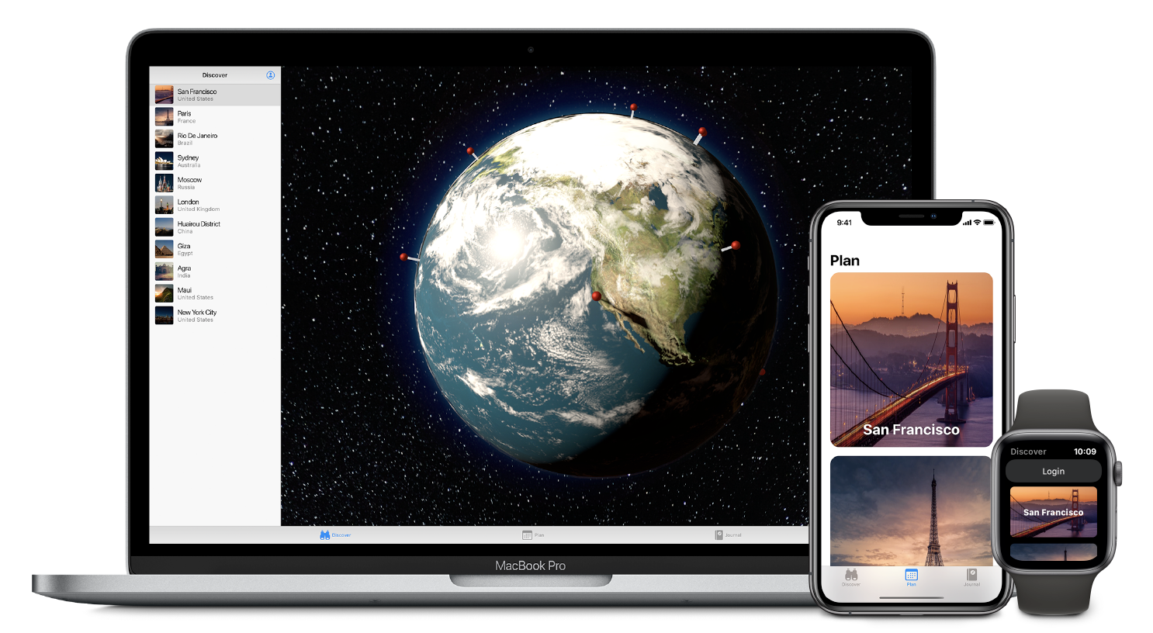
SwiftUI

Slide 8
SwiftUI
SwiftUI is an innovative, simple way to build user interfaces across all Apple platforms with the power of Swift.
It allows developers to build user interfaces for any Apple device using just one set of tools and APIs.
With a declarative Swift syntax that’s easy to read and natural to write, SwiftUI works seamlessly with new Xcode design tools to keep your code and design in sync.
It provides automatic support for Dynamic Type, Dark Mode, localization, and accessibility.

Slide 9
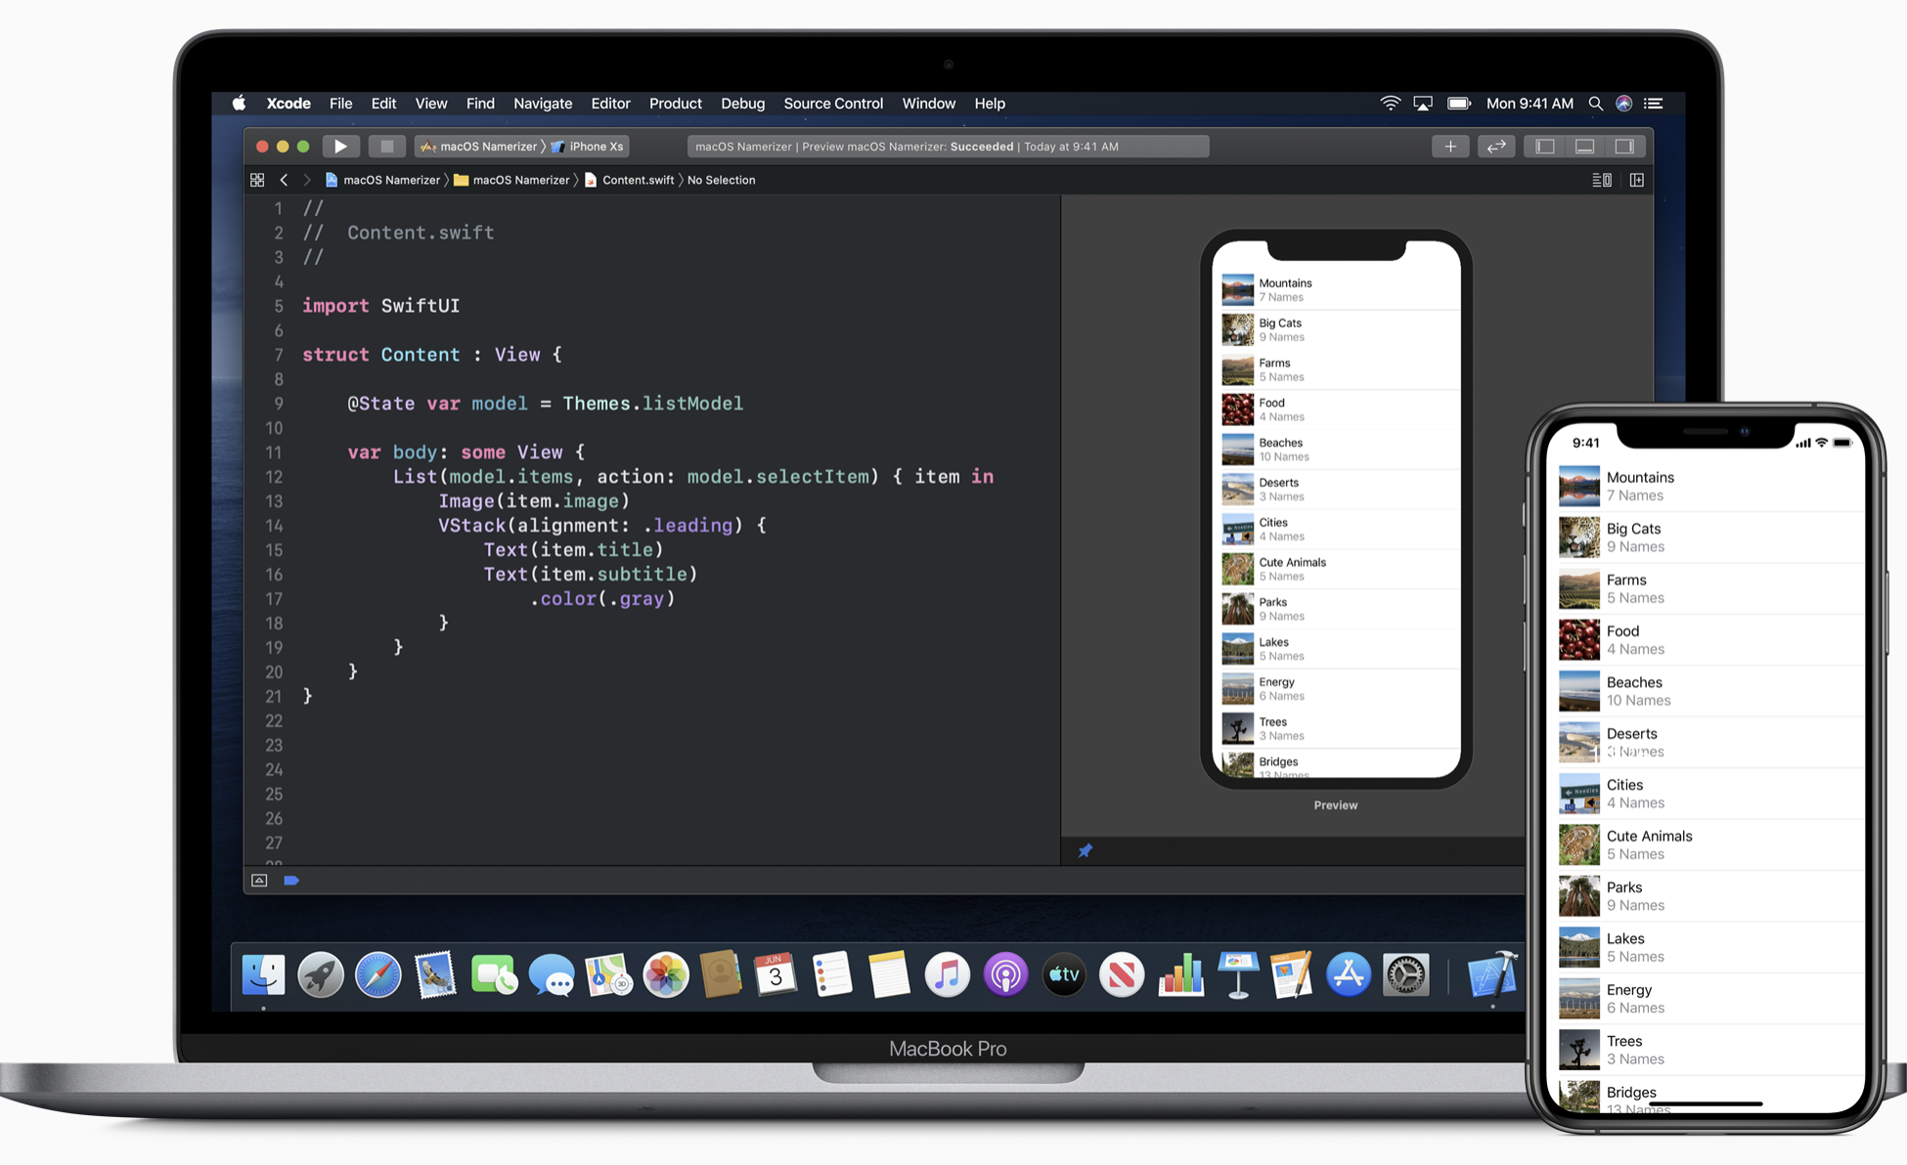

Slide 10
Declarative Syntax
SwiftUI uses a declarative syntax so you can simply state what your user interface should do. For example, you can write that you want a list of items consisting of text fields, then describe alignment, font, and color for each field. Your code is simpler and easier to read than ever before, saving you time and maintenance.
This declarative style even applies to complex concepts like animation. Easily add animation to almost any control and choose a collection of ready-to-use effects with only a few lines of code. At runtime, the system handles all of the steps needed to create a smooth movement, and even deals with interruption to keep your app stable. With animation this easy, you’ll be looking for new ways to make your app come alive.

Slide 11
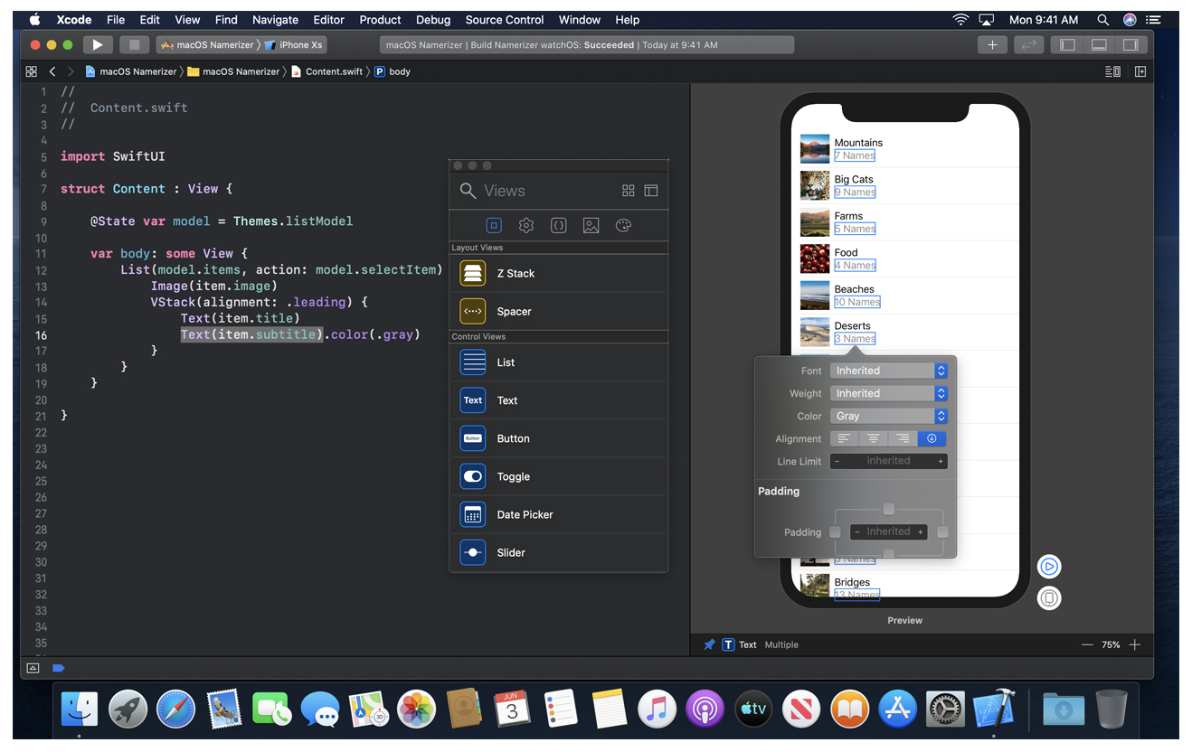
Design tools
Xcode 11 introduced intuitive new design tools that make building interfaces with SwiftUI as easy as dragging and dropping. It synchronizes the code and design. Code is instantly visible as a preview as you type, and any change you make to that preview immediately appears in your code. Xcode recompiles your changes instantly and inserts them into a running version of your app, visible, and editable at all times.

Slide 16



Tools
Icon generated using hotpot.ai
Size: 3x
Icon generated using hotpot.ai
Size: 2x
Icon generated using hotpot.ai
Size: 1x
https://hotpot.ai/icon-resizer

Slide 17
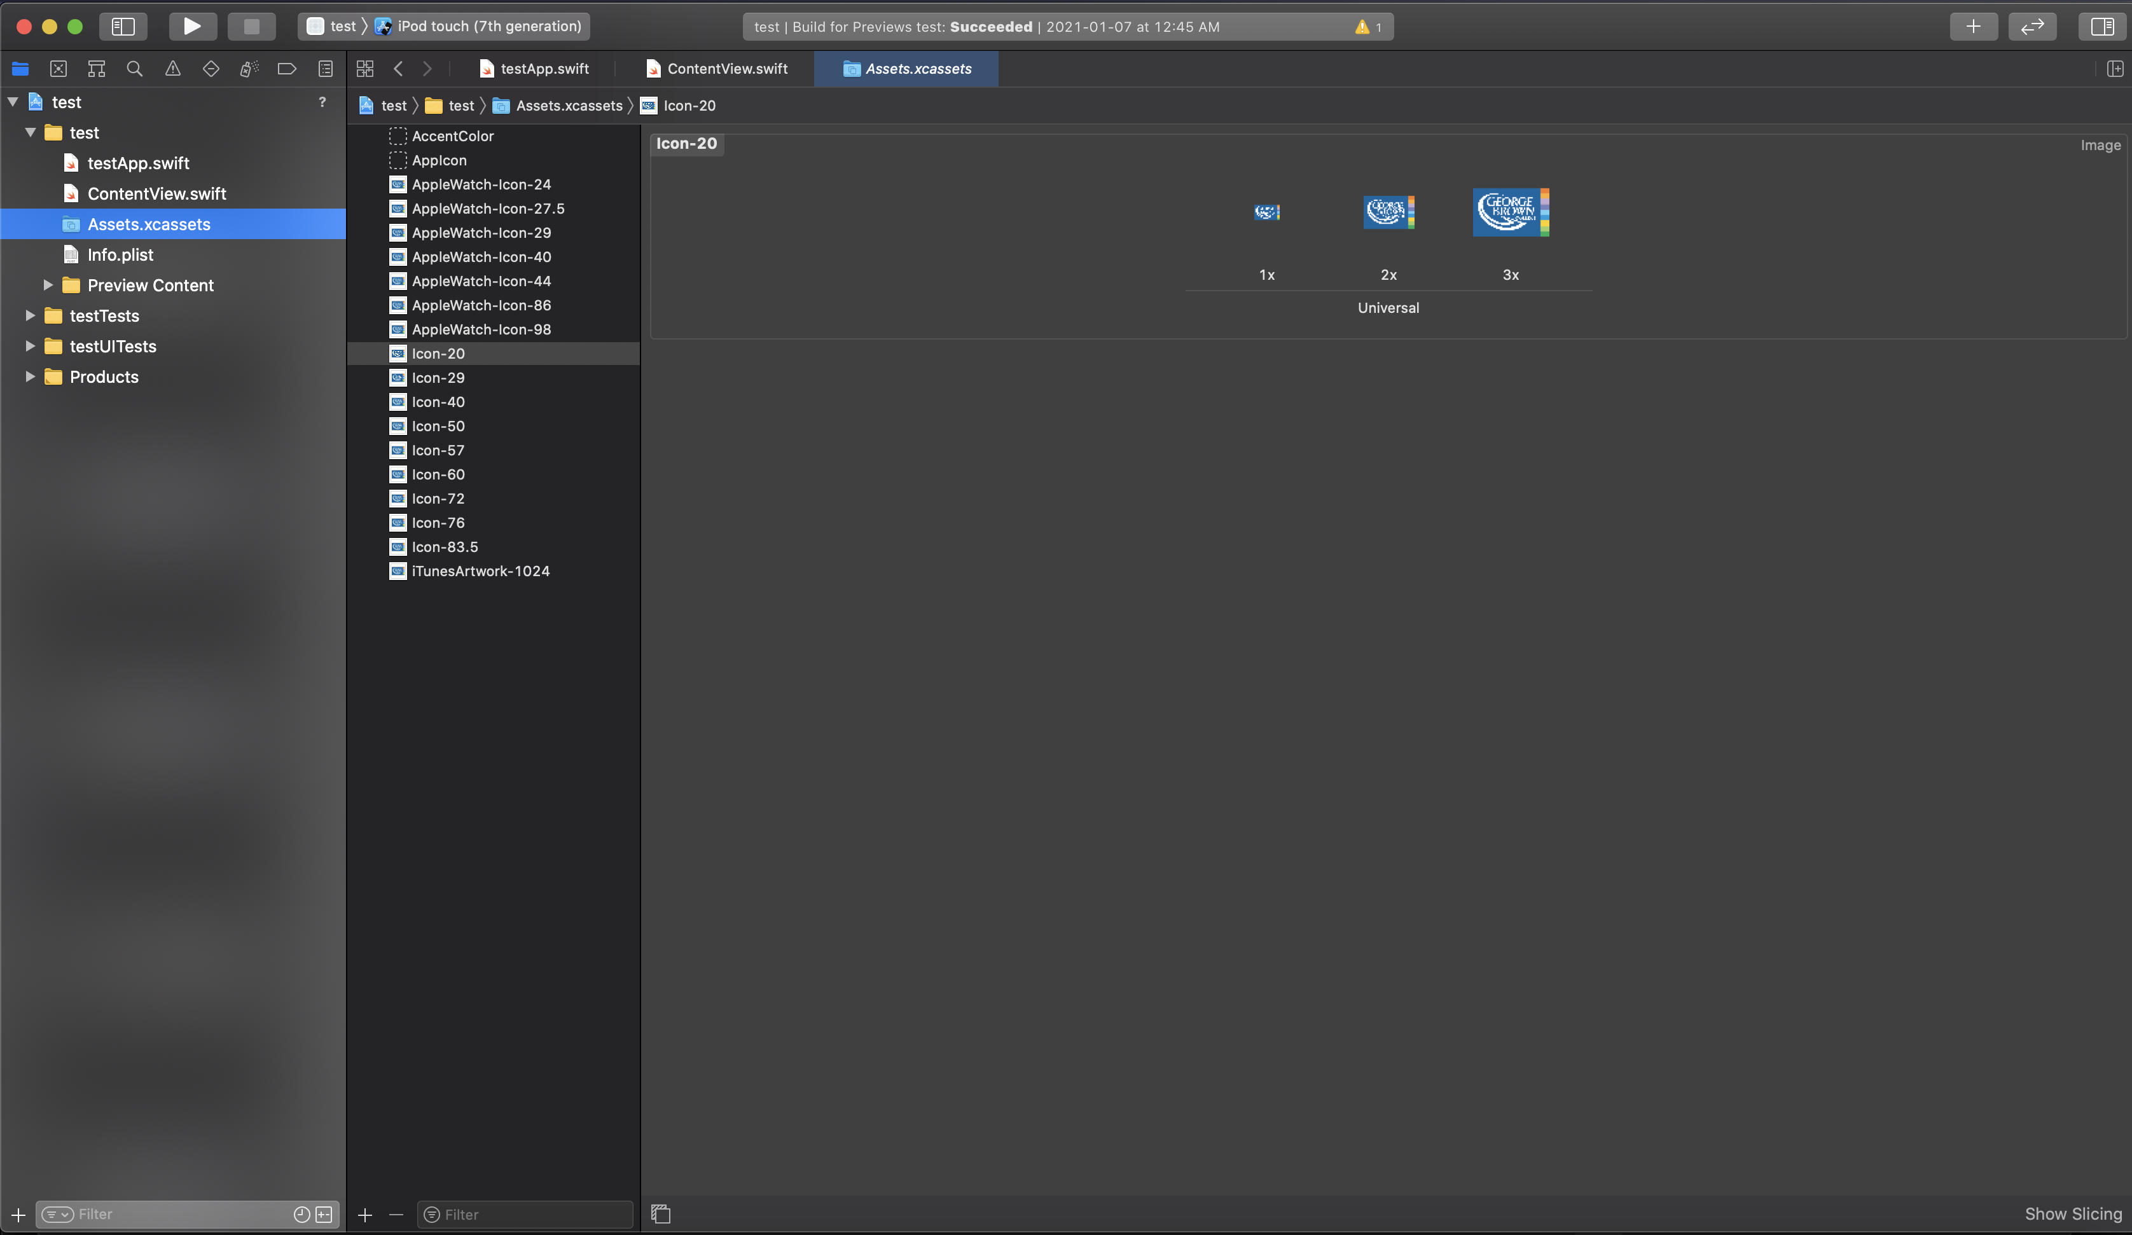

Slide 21
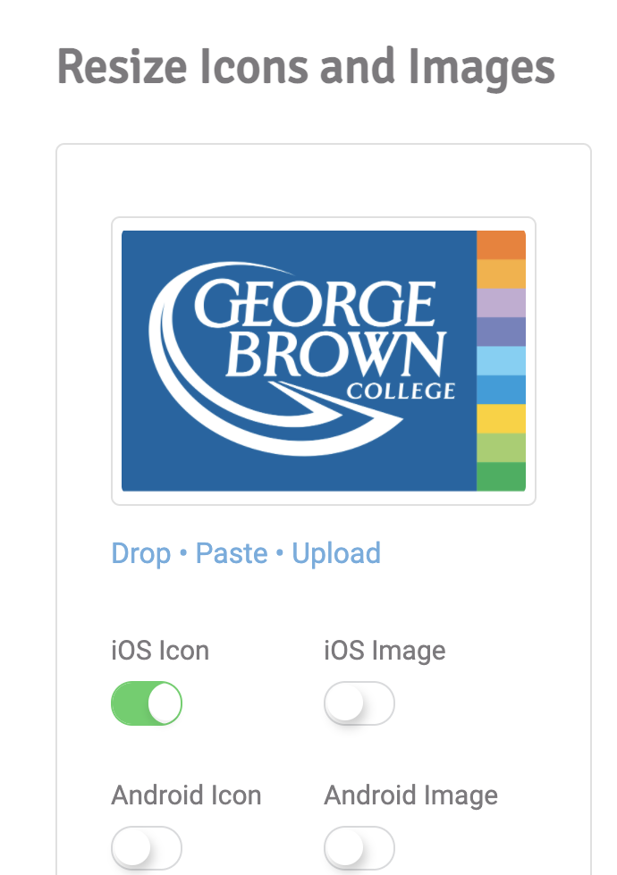
Many apps and sites to resize
https://hotpot.ai/icon-resizer

Slide 22
UI elements

